Slide 1

Introduction to Probabilistic Machine Learning
Ralf Herbrich
Linear Basis Function Models

Slide 2
Overview
Modelling Data
Modelling Text
Modelling Images
Linear Basis Function Models
Vector Spaces
Linear Mappings and Matrices

Slide 3
Overview
Modelling Data
Modelling Text
Modelling Images
Linear Basis Function Models
Vector Spaces
Linear Mappings and Matrices

Slide 4
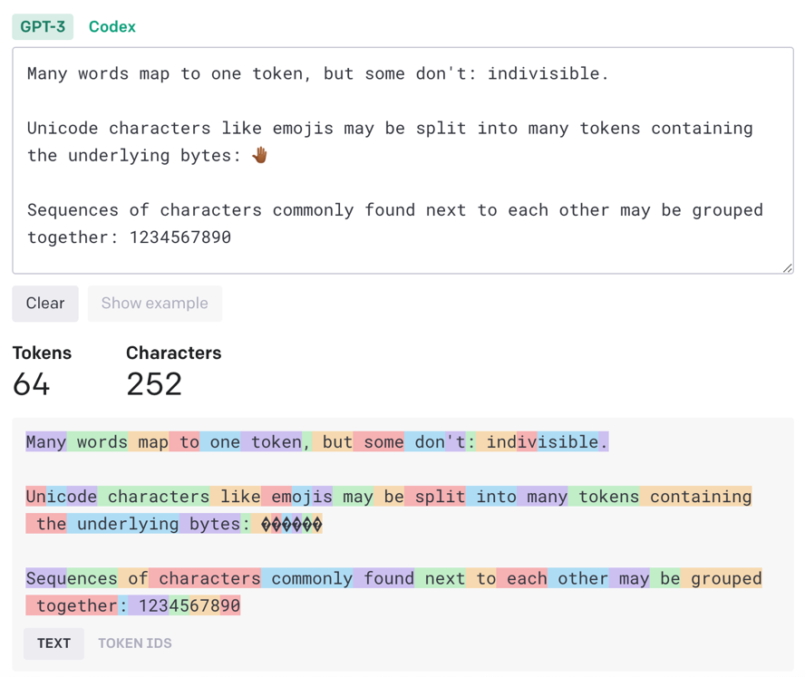

Modelling Text
Text can be modelled at three levels of granularity:
Letters ($≈{10}^{2}$ different letters in most alphabets)
Tokens (${10}^{3} to {10}^{4}$ different tokens in most alphabets)
Words (${10}^{5} to {10}^{6}$ different words in most languages)
Modelling level of granularity depends on the application
Letters: Compression algorithms for textual data
Tokens: Sequence prediction for question-answering
Words: Auto-correct function in smart keyboards

Slide 5
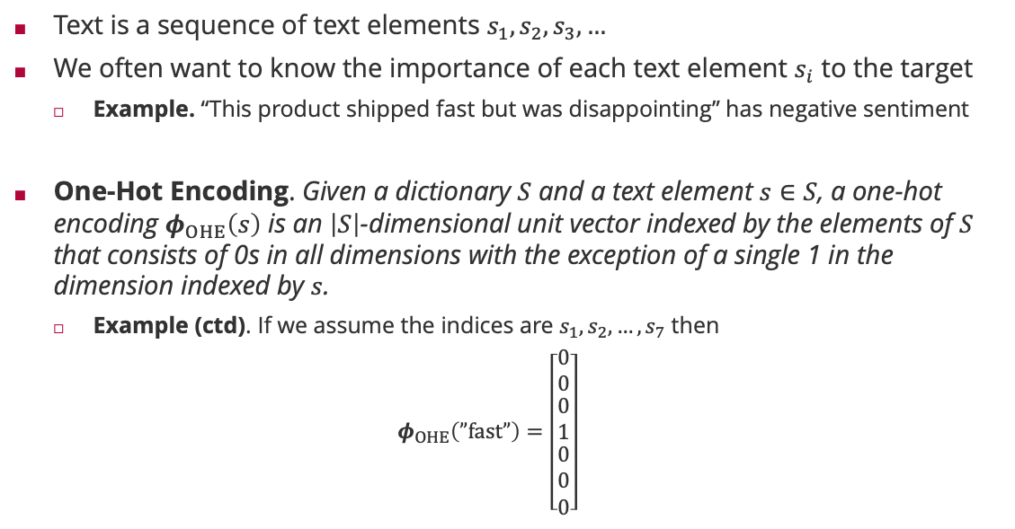
One-Hot Encoding
Text is a sequence of text elements $s_{1},s_{2},s_{3},…$
We often want to know the importance of each text element $s_{i}$ to the target
Example. “This product shipped fast but was disappointing” has negative sentiment
One-Hot Encoding. Given a dictionary $S$ and a text element $s∈S$, a one-hot encoding $φ_{OHE}\left(s\right)$ is an $\left|S\right|$-dimensional unit vector indexed by the elements of $S$ that consists of 0s in all dimensions with the exception of a single 1 in the dimension indexed by $s$.
Example (ctd). If we assume the indices are $s_{1},s_{2},…,s_{7}$ then
$$φ_{OHE}\left(”fast”\right)=\left[\begin{matrix}0 \\ 0 \\ \begin{matrix}0 \\ 1 \\ \begin{matrix}0 \\ 0 \\ 0\end{matrix}\end{matrix}\end{matrix}\right]$$
$$s_{1}$$
$$s_{2}$$
$$s_{3}$$
$$s_{4}$$
$$s_{5}$$
$$s_{6}$$
$$s_{7}$$
Text element that is likely the expression of bad sentiment
This product shipped fast but was disappointing

Slide 6
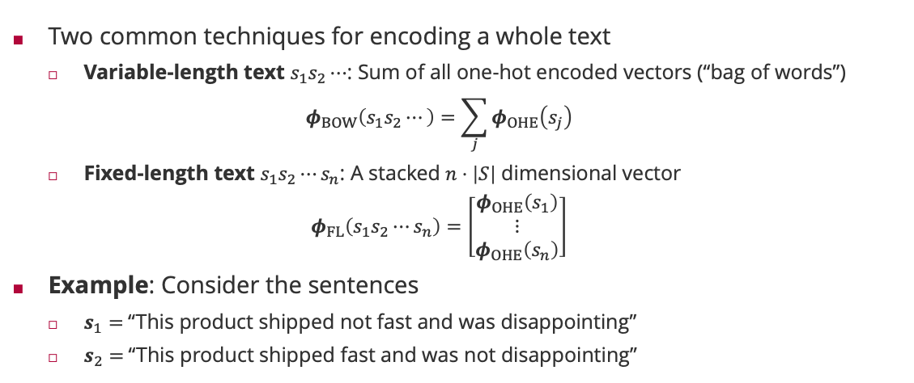
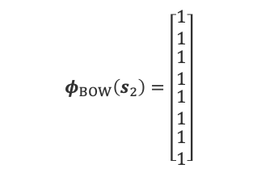
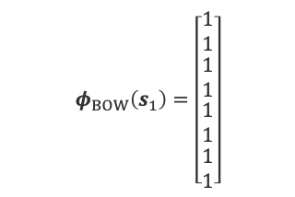
Modelling Whole Text
Two common techniques for encoding a whole text
Variable-length text $s_{1}s_{2}⋯$: Sum of all one-hot encoded vectors (“bag of words”)
$$φ_{BOW}\left(s_{1}s_{2}⋯\right)=\sum_{j}{φ_{OHE}\left(s_{j}\right)}$$
Fixed-length text $s_{1}s_{2}⋯s_{n}$: A stacked $n⋅\left|S\right|$ dimensional vector
$$φ_{FL}\left(s_{1}s_{2}⋯s_{n}\right)=\left[\begin{matrix}φ_{OHE}\left(s_{1}\right) \\ ⋮ \\ φ_{OHE}\left(s_{n}\right)\end{matrix}\right]$$
Example: Consider the sentences
$s_{1}=$“This product shipped not fast and was disappointing”
$s_{2}=$“This product shipped fast and was not disappointing”
$$φ_{BOW}\left(s_{1}\right)=\left[\begin{matrix}1 \\ 1 \\ \begin{matrix}1 \\ 1 \\ \begin{matrix}1 \\ 1 \\ \begin{aligned}1 \\ 1\end{aligned}\end{matrix}\end{matrix}\end{matrix}\right]$$
$$φ_{BOW}\left(s_{2}\right)=\left[\begin{matrix}1 \\ 1 \\ \begin{matrix}1 \\ 1 \\ \begin{matrix}1 \\ 1 \\ \begin{aligned}1 \\ 1\end{aligned}\end{matrix}\end{matrix}\end{matrix}\right]$$
This product shipped not fast and was
disappointing
This product shipped not fast and was
disappointing
Bag of words cannot learn “positional” effect of text elements

Slide 7
Overview
Modelling Data
Modelling Text
Modelling Images
Linear Basis Function Models
Vector Spaces
Linear Mappings and Matrices

Slide 8
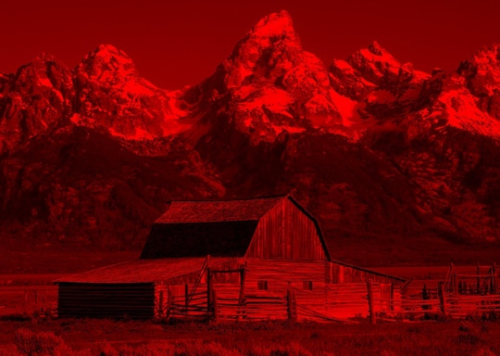
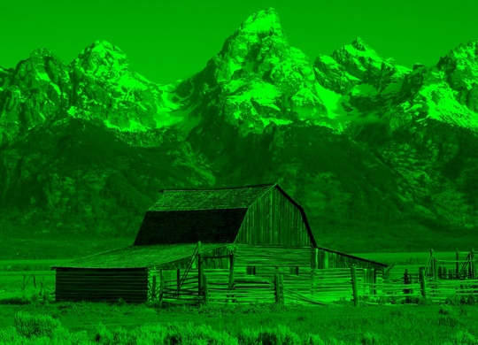
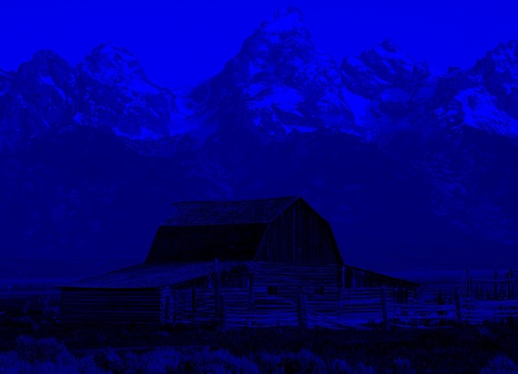
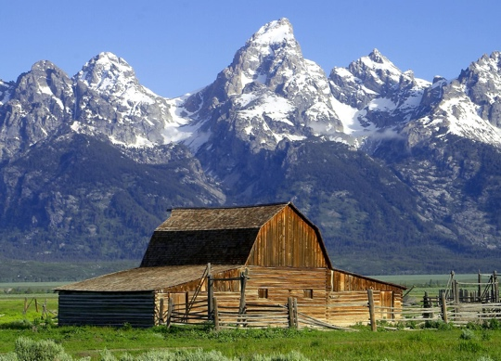
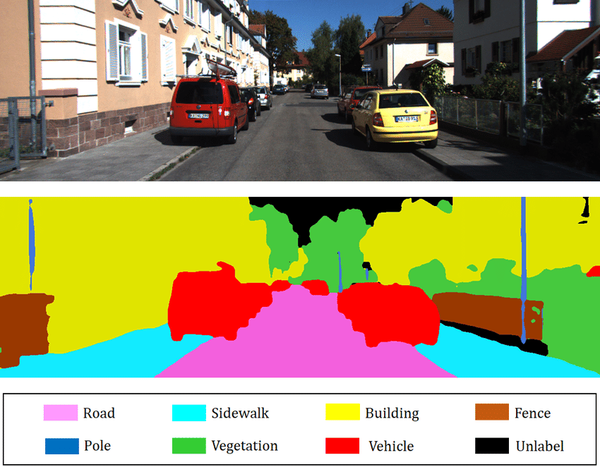
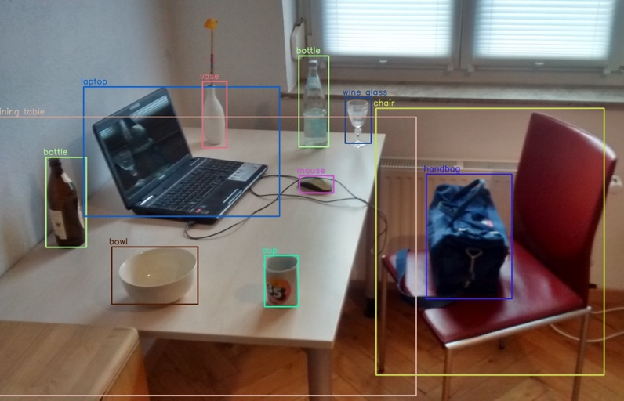
Modelling Images
Raw image data. An image is a rectangular array of picture elements (“pixels”) that consist of a triple of intensities of the base colors red, blue, and green.
Images can also be modelled at three levels of granularity depending on application
Pixels: Image segmentation
(Non-overlapping) patches: Object recognition
Whole image: Image classification

Slide 9


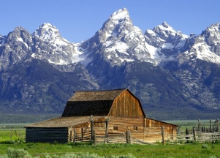
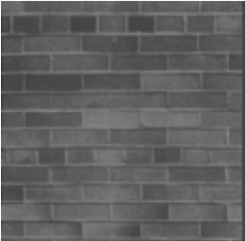
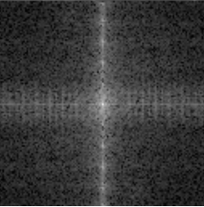
Image Content in Frequency and Location
Image data contains signal (photon counts) at fixed locations in the image
$$φ_{RGB}\left(\begin{matrix} & & \\ & & \\ & & \end{matrix}\right)=\left[\begin{matrix}127 \\ 0 \\ \begin{matrix}⋮ \\ 32 \\ 6\end{matrix}\end{matrix}\right]$$
Observation. Recurring patterns are more visible in the frequency domain.
Idea. Discrete Fourier transform (DFT) to transform the image
$$φ_{DFT}\left(x\right)=F_{DFT}φ_{RGB}\left(x\right)$$
In practice, there is a $𝒪\left(\#pixel⋅\log\left(\#pixel\right)\right)$ algorithm for fast Fourier transform (FFT)
Red value at location (1,1)
Green value at location (1,1)
Green value at location (800,600)
Blue value at location (800,600)
$$F_{DFT}=W_{DFT}⊗W_{DFT}$$
Kronecker product of 1D discrete Fourier transform $W_{DFT}$
Horizontal and vertical patterns by single features
Raw image (in single-grey channel)
Fourier transform of image

Slide 10
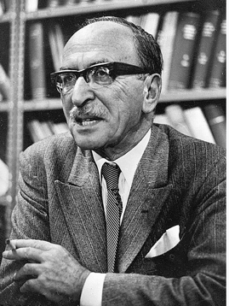



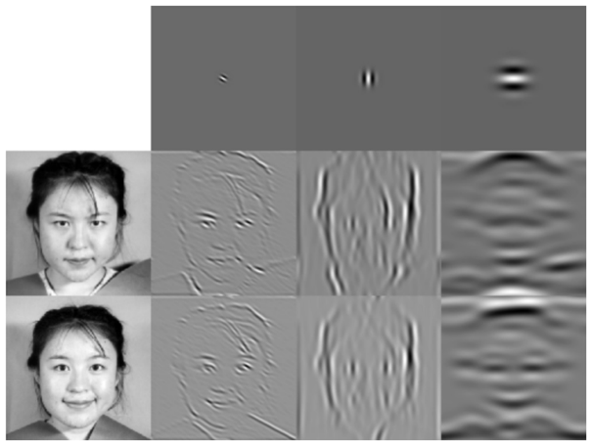
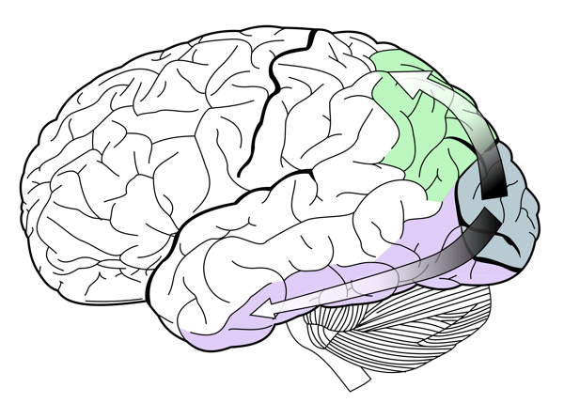
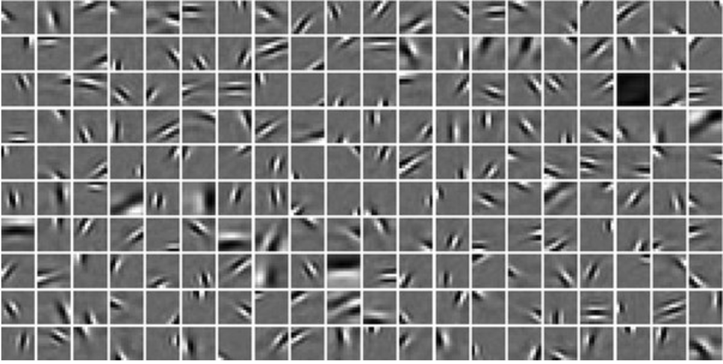
Gabor Wavelets: Mixing Location and Frequency
Both representations are extremes:
Raw image: Single features $φ_{RGB,i}\left(x\right)$ at a location without frequency
DFT image: Single features $φ_{DFT,i}\left(x\right)$ in frequency without a location
Gabor wavelets. A Gabor wavelet is a set of basis functions that is obtained by multiplying a Fourier basis function with a Gaussian density.
Combine both spatial and frequency information in image features
Basis functions for sparse encoding by the brain in V1
Dennis Gabor (1900 – 1978)
V1 area
Filters “implemented” in the V1 (sparse coding!)
Bruno Olshausen & David Field (1997). Sparse Coding with Overcomplete Basis Set: A Strategy Employed by V1?

Slide 11
Overview
Modelling Data
Modelling Text
Modelling Images
Linear Basis Function Models
Vector Spaces
Linear Mappings and Matrices

Slide 12
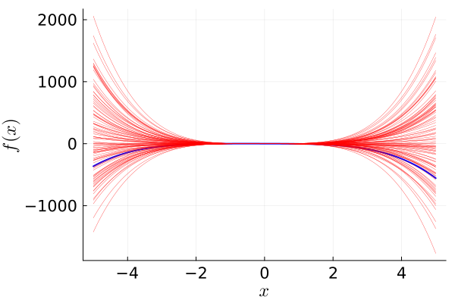
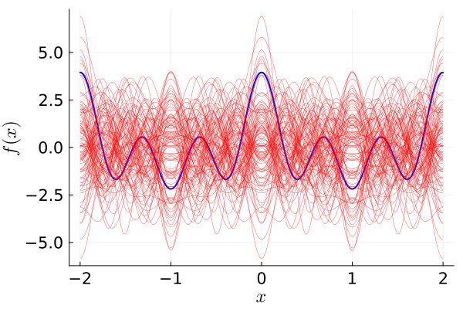
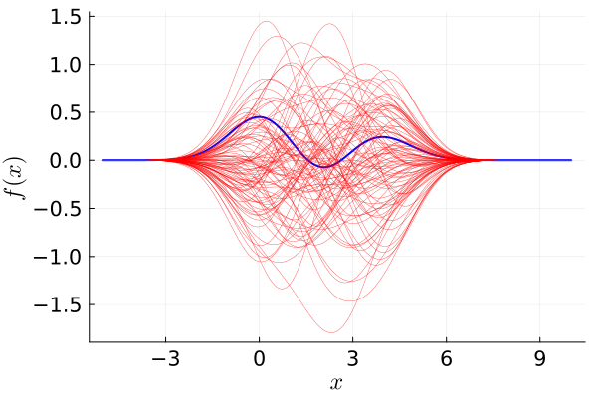
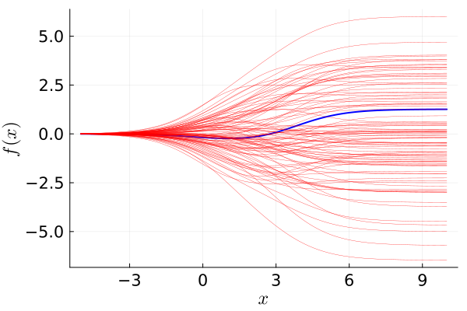


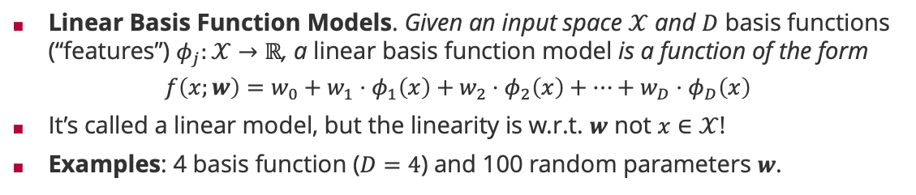

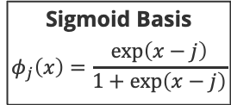
Linear Basis Function Models
Linear Basis Function Models. Given an input space $𝒳$ and $D$ basis functions (“features”) $φ_{j}:𝒳→ℝ$, a linear basis function model is a function of the form
$$f\left(x;w\right)=w_{0}+w_{1}⋅φ_{1}\left(x\right)+w_{2}⋅φ_{2}\left(x\right)+⋯+w_{D}⋅φ_{D}\left(x\right)$$
It’s called a linear model, but the linearity is w.r.t. $w$ not $x∈𝒳$!
Examples: 4 basis function ($D=4$) and 100 random parameters $w$.
Sigmoid Basis
$$φ_{j}\left(x\right)=\frac{exp\left(x−j\right)}{1+\exp\left(x−j\right)}$$
Polynomial Basis
$$φ_{j}\left(x\right)=x^{j}$$
Fourier Basis
$$φ_{j}\left(x\right)=\cos\left(πj⋅x\right)$$
Gaussian Basis
$$φ_{j}\left(x\right)=𝒩\left(x;j,1\right)$$

Slide 13
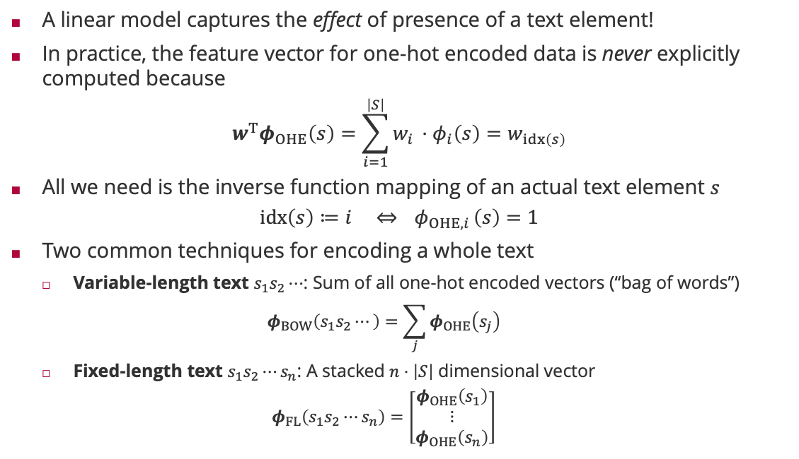



Linear Models for Text
A linear model captures the effect of presence of a text element!
In practice, the feature vector for one-hot encoded data is never explicitly computed because
$$w^{T}φ_{OHE}\left(s\right)=\sum_{i=1}^{\left|S\right|}{w_{i }⋅φ_{i}\left(s\right)}=w_{idx\left(s\right)}$$
All we need is the inverse function mapping of an actual text element $s$
$$idx\left(s\right)≔i ⇔{ φ}_{OHE,i}\left(s\right)=1$$
Two common techniques for encoding a whole text
Variable-length text $s_{1}s_{2}⋯$: Sum of all one-hot encoded vectors (“bag of words”)
$$φ_{BOW}\left(s_{1}s_{2}⋯\right)=\sum_{j}{φ_{OHE}\left(s_{j}\right)}$$
Fixed-length text $s_{1}s_{2}⋯s_{n}$: A stacked $n⋅\left|S\right|$ dimensional vector
$$φ_{FL}\left(s_{1}s_{2}⋯s_{n}\right)=\left[\begin{matrix}φ_{OHE}\left(s_{1}\right) \\ ⋮ \\ φ_{OHE}\left(s_{n}\right)\end{matrix}\right]$$
$$𝒪\left(\left|S\right|\right)$$
$$𝒪\left(\log_{2}\left|S\right|\right)$$
A linear model is only $𝒪\left(n⋅\log_{2}\left|S\right|\right)$

Slide 14
Overview
Modelling Data
Modelling Text
Modelling Images
Linear Basis Function Models
Vector Spaces
Linear Mappings and Matrices

Slide 15
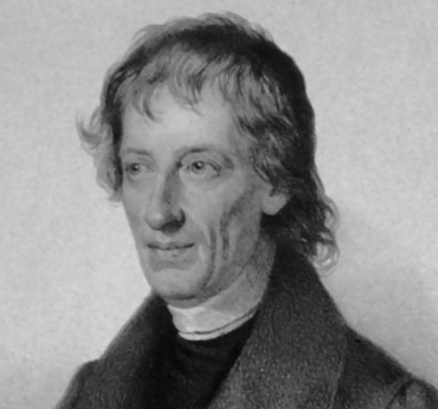
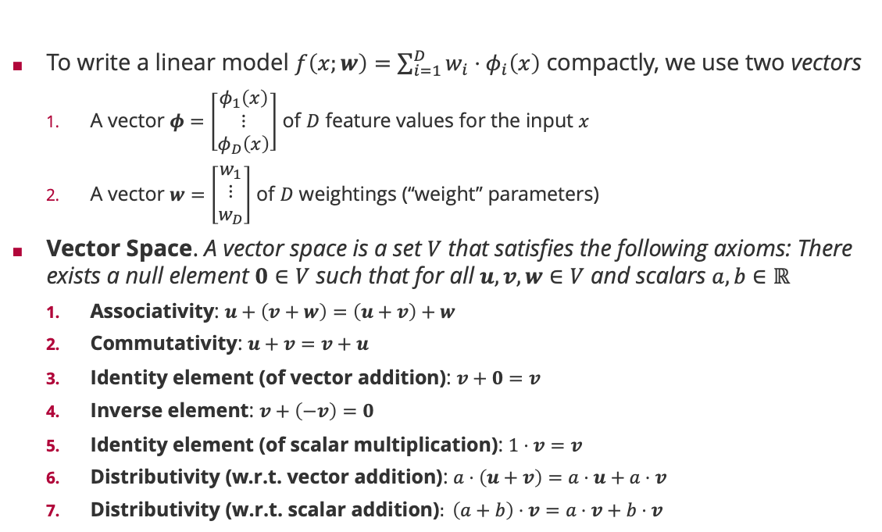
Linear Models and Vector Spaces
To write a linear model $f\left(x;w\right)=\sum_{i=1}^{D}{w_{i}⋅φ_{i}\left(x\right)}$ compactly, we use two vectors
A vector $φ=\left[\begin{matrix}φ_{1}\left(x\right) \\ ⋮ \\ φ_{D}\left(x\right)\end{matrix}\right]$ of $D$ feature values for the input $x$
A vector $w=\left[\begin{matrix}w_{1} \\ ⋮ \\ w_{D}\end{matrix}\right]$ of $D$ weightings (“weight” parameters)
Vector Space. A vector space is a set $V$ that satisfies the following axioms: There exists a null element $0∈V$ such that for all $u,v,w∈V$ and scalars $a,b∈ℝ$
Associativity: $u+\left(v+w\right)=\left(u+v\right)+w$
Commutativity: $u+v=v+u$
Identity element (of vector addition): $v+0=v$
Inverse element: $v+\left(−v\right)=0$
Identity element (of scalar multiplication): $1⋅v=v$
Distributivity (w.r.t. vector addition): $a⋅\left(u+v\right)=a⋅u+a⋅v$
$\text{Distributivity}\text{ (}\text{w}\text{.}\text{r}\text{.}\text{t}\text{. }\text{scalar} \text{addition}\text{)}: \left(a+b\right)⋅v=a⋅v+b⋅v$
Bernhard Bolzano (1781 – 1848)

Slide 16












Linear Independence, Span and Basis
$$v_{2}$$
$$v_{2}$$
Linear combination. Given a set $v_{1},v_{2},…,v_{n}$ of a vector space $V$, a linear combination is defined by ($a_{1},a_{2},…,a_{n}$ are called coefficients)
$$a_{1}⋅v_{1}+a_{2}⋅v_{2}+⋯+a_{n}⋅v_{n}$$
Linear independence. A set $v_{1},v_{2},…,v_{n}$ is called linearly independent if no $v_{i}$ can be written as a linear combination of $v_{1},…,v_{i−1},v_{i+1},…,v_{n}$.
Span. Given a set $v_{1},v_{2},…,v_{n}$ of a vector space $V$, the span $span\left(v_{1},v_{2},…,v_{n}\right)$ is the set of all linear combinations of $v_{1},v_{2},…,v_{n}$.
Example:
$span\left(v_{1}\right)$ is the line through the origin along $v_{1}$
$span\left(v_{1},v_{2}\right)$ is the plane through the origin along $v_{1}$ and $v_{2}$
Basis. A subset $b_{1},b_{2},…,b_{n}$ of a vector space $V$ is called a basis if its span equals the whole vector space, that is, $span\left(b_{1},b_{2},…,b_{n}\right)=V$.
Dimensionality. All bases of a vector space $V$ have the same cardinality called the dimensionality of the vector space, $\dim\left(V\right)$.
$$v_{1}$$
$$v_{1}+2⋅v_{2}$$
$$v_{1}$$
$$v_{1}$$
$$v_{3}$$
$$v_{2}$$
$$v_{2}$$
$$v_{1}$$
$$v_{2}$$

Slide 17







































































































Example: Linear Independence & Span
Consider two 28x28 pictures and and their ${28}^{2}=784$-dimensional $φ_{RGB}$ embedding
$$φ=α_{2}⋅φ_{RGB}\left( \right)$$
$$φ=α_{1}⋅φ_{RGB}\left( \right)+α_{2}⋅φ_{RGB}\left( \right)$$
$$φ=α_{1}⋅φ_{RGB}\left( \right)$$

Slide 18
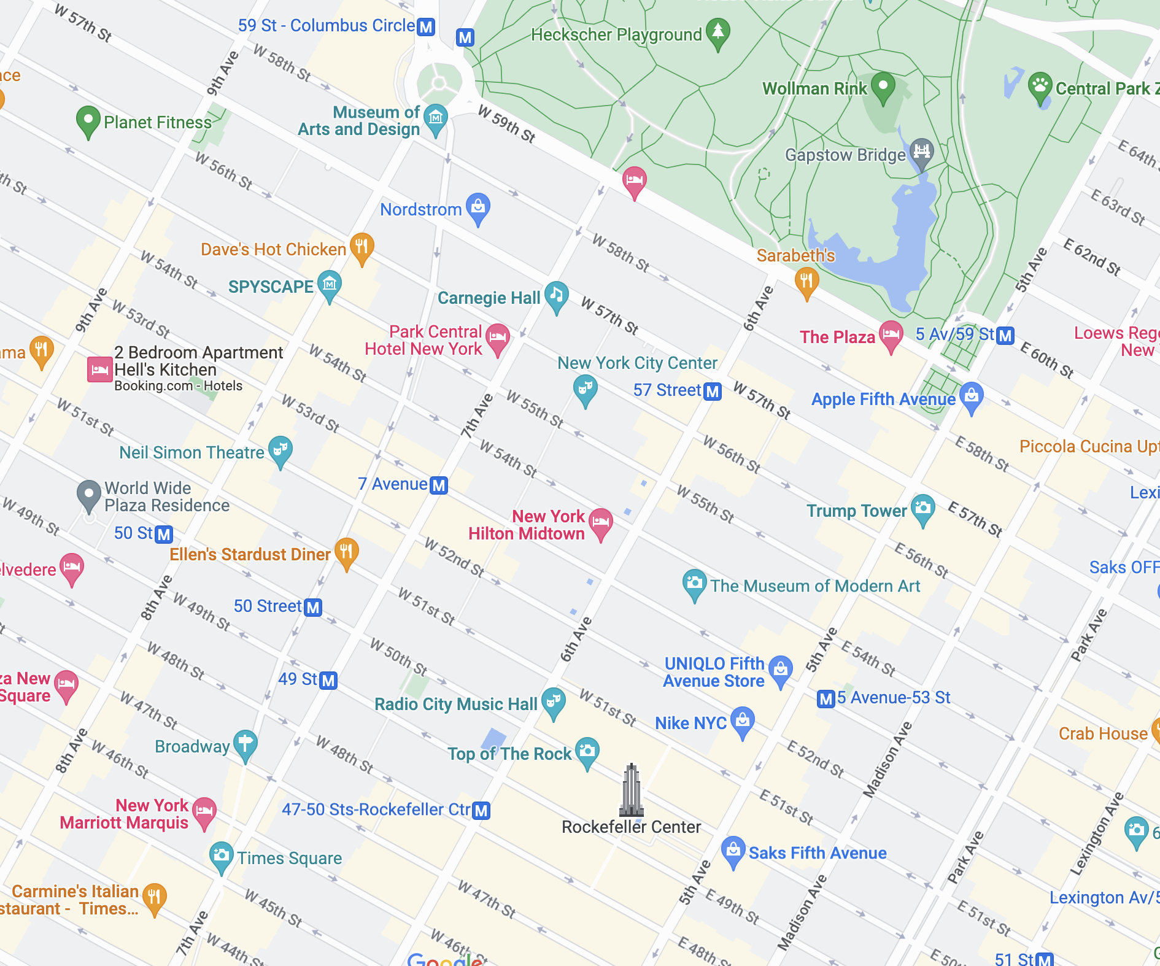
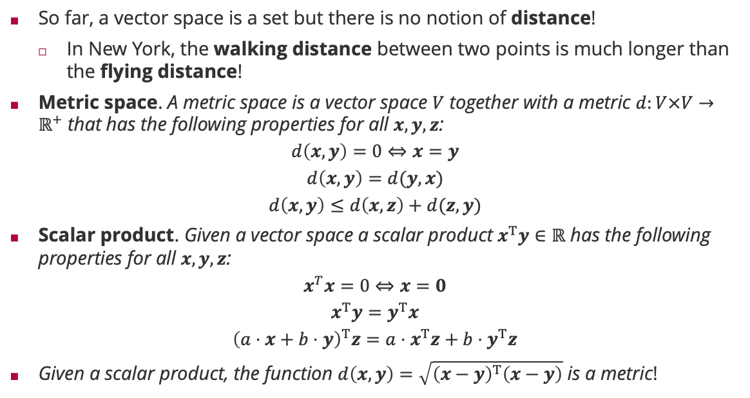
Distances and Scalar Products
So far, a vector space is a set but there is no notion of distance!
In New York, the walking distance between two points is much longer than the flying distance!
Metric space. A metric space is a vector space $V$ together with a metric $d:V×V→ℝ^{+}$ that has the following properties for all $x,y,z$:
$$d\left(x,y\right)=0⇔x=y$$
$$d\left(x,y\right)=d(y,x)$$
$$d\left(x,y\right)≤d\left(x,z\right)+d(z,y)$$
Scalar product. Given a vector space a scalar product $x^{T}y∈ℝ$ has the following properties for all $x,y,z$:
$$x^{T}x=0⇔x=0$$
$$x^{T}y=y^{T}x$$
$${\left(a⋅x+b⋅y\right)}^{T}z=a⋅x^{T}z+b⋅y^{T}z$$
Given a scalar product, the function $d\left(x,y\right)=\sqrt{{\left(x−y\right)}^{T}\left(x−y\right)}$ is a metric!
symmetry
triangle inequality
symmetry
linearity

Slide 19
Overview
Modelling Data
Modelling Text
Modelling Images
Linear Basis Function Models
Vector Spaces
Linear Mappings and Matrices

Slide 20
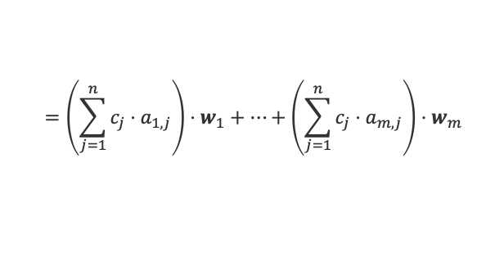


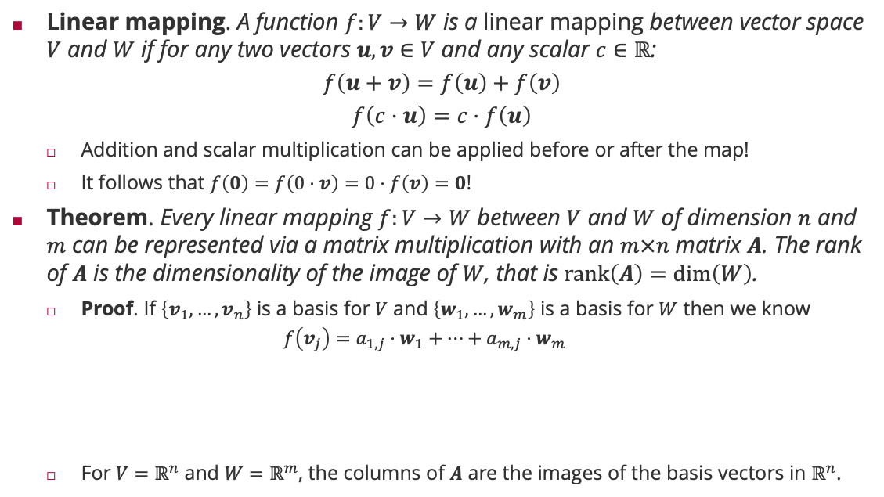





Linear Mappings and Matrices
Linear mapping. A function $f:V→W$ is a linear mapping between vector space $V$ and $W$ if for any two vectors $u,v∈V$ and any scalar $c∈ℝ$:
$$f\left(u+v\right)=f\left(u\right)+f\left(v\right)$$
$$f\left(c⋅u\right)=c⋅f\left(u\right)$$
Addition and scalar multiplication can be applied before or after the map!
It follows that $f\left(0\right)=f\left(0⋅v\right)=0⋅f\left(v\right)=0$!
Theorem. Every linear mapping $f:V→W$ between $V$ and $W$ of dimension $n$ and $m$ can be represented via a matrix multiplication with an $m×n$ matrix $A$. The rank of $A$ is the dimensionality of the image of $W$, that is $rank\left(A\right)=\dim\left(W\right)$.
Proof. If $\left\{v_{1},…,v_{n}\right\}$ is a basis for $V$ and $\left\{w_{1},…,w_{m}\right\}$ is a basis for $W$ then we know
$$f\left(v_{j}\right)=a_{1,j}⋅w_{1}+⋯+a_{m,j}⋅w_{m}$$
For $V=ℝ^{n}$ and $W=ℝ^{m}$, the columns of $A$ are the images of the basis vectors in $ℝ^{n}$.
$$f\left(x\right)=\left[\begin{matrix}1 & 1 \\ 0 & 1\end{matrix}\right] x$$
because $v_{1},…,v_{n}$ is a basis
because $w_{1},…,w_{m}$ is a basis
$$f\left(v\right)=f\left(c_{1}v_{1}+⋯+c_{n}v_{n}\right)$$
$$=c_{1}⋅f\left(v_{1} \right)+⋯+c_{n}⋅f\left(v_{n}\right)$$
because $f$ is a linear mapping
$$=\left(\sum_{j=1}^{n}{c_{j}⋅a_{1,j}}\right)⋅w_{1}+⋯+\left(\sum_{j=1}^{n}{c_{j}⋅a_{m,j}}\right)⋅w_{m}$$
$${\left[Ac\right]}_{m}$$

Slide 21
















Example: Linear Mappings and Matrices
Consider a 28x28 picture and its ${28}^{2}=784$-dimensional $φ_{RGB}$ embedding
Then the rotation of the image content can be expressed as a linear mapping from $784$-dimensional onto itself
By computing the four fractional source pixel that contributed to a target pixel
The following movie was produced by 120 linear mappings of $3°$ applied to the same $784$-dimensional $φ_{RGB}$ embedding of the source image
$$A_{−22.5°}∈ℝ^{784×784}$$
$$A_{+22.5°}∈ℝ^{784×784}$$
$$v∈ℝ^{784}$$
$$w_{−22.5°}$$
original $v$
$$w_{+22.5°}$$
$$v∈ℝ^{784}$$
$$=$$
$$=$$

Slide 22
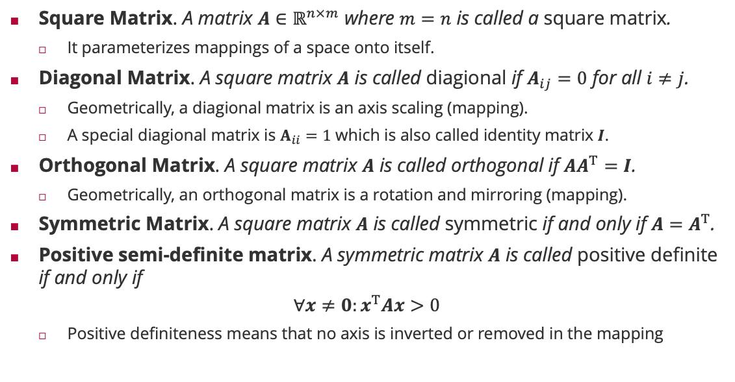
Matrix Types and Properties
Square Matrix. A matrix $A∈ℝ^{n×m}$ where $m=n$ is called a square matrix.
It parameterizes mappings of a space onto itself.
Diagonal Matrix. A square matrix $A$ is called diagional if $A_{ij}=0$ for all $i≠j$.
Geometrically, a diagional matrix is an axis scaling (mapping).
A special diagional matrix is $A_{ii}=1$ which is also called identity matrix $I$.
Orthogonal Matrix. A square matrix $A$ is called orthogonal if ${AA}^{T}=I$.
Geometrically, an orthogonal matrix is a rotation and mirroring (mapping).
Symmetric Matrix. A square matrix $A$ is called symmetric if and only if $A=A^{T}$.
Positive semi-definite matrix. A symmetric matrix $A$ is called positive definite if and only if
$$∀x≠0:x^{T}Ax>0$$
Positive definiteness means that no axis is inverted or removed in the mapping

Slide 23





Singular Value Decomposition
Singular Value Decomposition. Any matrix $A∈ ℝ^{n×m}$ has a decomposition into three matrices $U∈ ℝ^{n×k}$, $Σ∈ ℝ^{k×k}$ and $V∈ ℝ^{m×k}$ such that $U^{T}U=I$ and $V^{T}V=I$ and $Σ$ is only non-zero on diagonal elements (where $k=rank\left(A\right)$)
$$A=UΣV^{T}$$
$$f\left(x\right)=Ax$$
$$V^{T} x$$
$$UΣV^{T} x$$
$$ΣV^{T} x$$

Slide 24























Singular Value Decomposition Example
Imagine we arrange the 784-dimensional RGB vectors for 1000 images of digits in the rows of a matrix $A$. Then the SVD has the following property
Reconstruction with $\hat{A}=\left[\begin{matrix}u_{1} & ⋯ & u_{k}\end{matrix}\right]⋅\left[\begin{matrix}b_{1}^{T} \\ ⋮ \\ b_{k}^{T}\end{matrix}\right]$ for the first $k$ singular values
$$=\left[\begin{matrix}u_{1} & ⋯ & u_{784}\end{matrix}\right]⋅\left[\begin{matrix}b_{1}^{T} \\ ⋮ \\ b_{784}^{T}\end{matrix}\right]$$
$$A=UΣV^{T}$$
$$=UB$$
$$U∈ℝ^{1000×784}$$
$$=B∈ℝ^{784×784}$$
First 5 rows of $B$
$$b_{1}$$
$$b_{2}$$
$$b_{3}$$
$$b_{4}$$
$$b_{5}$$
$$∈ℝ^{k×784}$$
$$∈ℝ^{1000×k}$$
Original $a_{1}$
Reconstruction ${\hat{a}}_{1}$

Slide 25





Inverse of a Matrix and SVD
Inverse. The inverse $A^{−1}$ of a full-rank square matrix $A$ has the property that
$$A^{−1}A=AA^{−1}=I$$
One way to compute it is with the singular value decomposition
$$A^{−1}={{VΣ}^{−1}U}^{T}$$
$$f\left(x\right)=Ax$$
$$f^{−1}\left(x\right)=A^{−1}x$$
$${{VΣ}^{−1}U}^{T} x$$
$$U^{T} x$$
$$Σ^{−1}U^{T} x$$

Slide 26
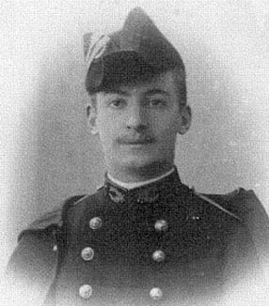



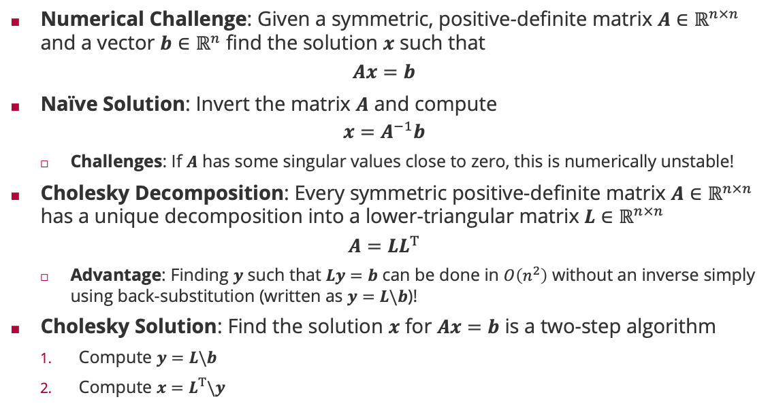





Cholesky Decomposition
Numerical Challenge: Given a symmetric, positive-definite matrix $A∈ℝ^{n×n}$ and a vector $b∈ℝ^{n}$ find the solution $x$ such that
$$Ax=b$$
Naïve Solution: Invert the matrix $A$ and compute
$$x=A^{−1}b$$
Challenges: If $A$ has some singular values close to zero, this is numerically unstable!
Cholesky Decomposition: Every symmetric positive-definite matrix $A∈ℝ^{n×n}$ has a unique decomposition into a lower-triangular matrix $L∈ℝ^{n×n}$
$$A=LL^{T}$$
Advantage: Finding $y$ such that $Ly=b$ can be done in $O\left(n^{2}\right)$ without an inverse simply using back-substitution (written as $y=L\backslash b$)!
Cholesky Solution: Find the solution $x$ for $Ax=b$ is a two-step algorithm
Compute $y=L\backslash b$
Compute $x=L^{T}\backslash y$
André-Louis Cholesky (1875 – 1918)
$$\left(\begin{matrix}L_{11} & 0 & 0 \\ L_{21} & L_{22} & 0 \\ L_{31} & L_{32} & L_{33}\end{matrix}\right)$$
$$\left(\begin{matrix}y_{1} \\ y_{2} \\ y_{3}\end{matrix}\right)$$
$$=\left(\begin{matrix}b_{1} \\ b_{2} \\ b_{3}\end{matrix}\right)$$
$$y_{1}=\frac{b_{1}}{L_{11}}$$
$$y_{2}=\frac{b_{2}−L_{21}⋅y_{1}}{L_{22}}$$
$$Ax=b⇔LL^{T}x=b$$
$$y_{3}=\frac{b_{3}−L_{31}⋅y_{1}−L_{32}⋅y_{2}}{L_{33}}$$
$$Ly=b$$

Slide 27
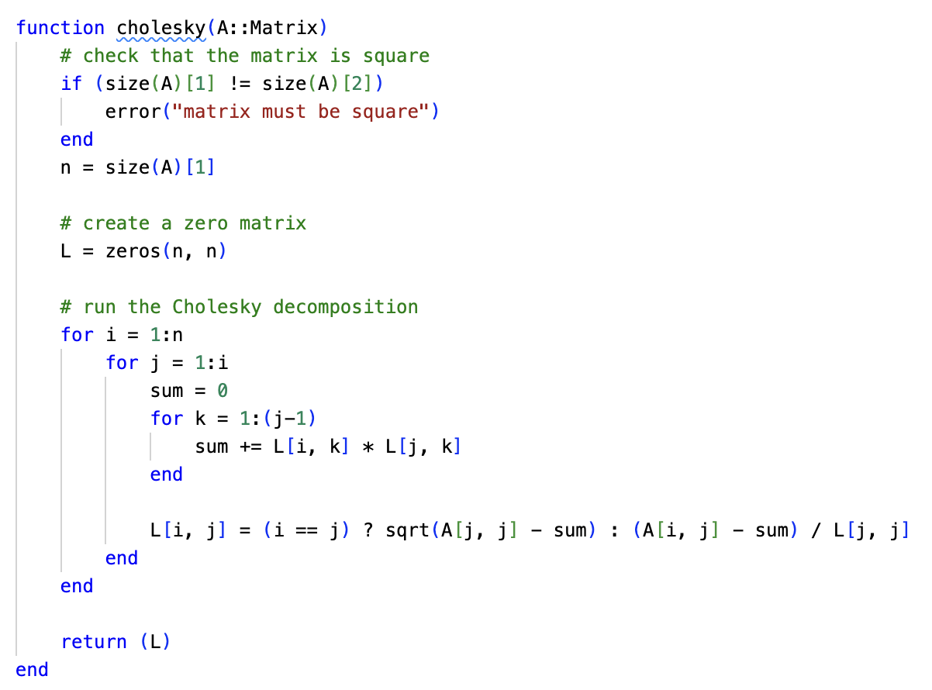





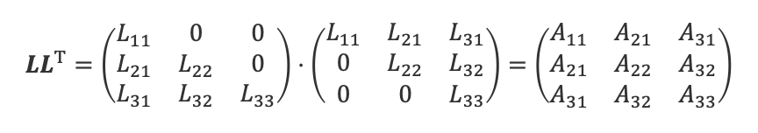







Cholesky Decomposition (ctd)
$$LL^{T}=\left(\begin{matrix}L_{11} & 0 & 0 \\ L_{21} & L_{22} & 0 \\ L_{31} & L_{32} & L_{33}\end{matrix}\right)⋅\left(\begin{matrix}L_{11} & L_{21} & L_{31} \\ 0 & L_{22} & L_{32} \\ 0 & 0 & L_{33}\end{matrix}\right)=\left(\begin{matrix}A_{11} & A_{21} & A_{31} \\ A_{21} & A_{22} & A_{32} \\ A_{31} & A_{32} & A_{33}\end{matrix}\right)$$
1
1
2
4
1
2
4
2
3
3
5
2
3
5
4
5
6
6
4
5
6
1
$$L_{11}^{2}=A_{11}$$
$$L_{11}=\sqrt{A_{11}}$$
2
$$L_{11}⋅L_{21}=A_{21}$$
$$L_{21}=\frac{A_{21}}{L_{11}}$$
3
$${L_{21}^{2}+L}_{22}^{2}=A_{22}$$
$$L_{22}=\sqrt{A_{22}−L_{21}^{2}}$$
4
$$L_{11}⋅L_{31}=A_{31}$$
$$L_{31}=\frac{A_{31}}{L_{11}}$$
5
$$L_{21}⋅L_{31}+L_{22}⋅L_{32}=A_{32}$$
$$L_{32}=\frac{A_{32}−L_{21}⋅L_{31}}{L_{22}}$$
6
$$L_{31}^{2}+L_{32}^{2}+L_{33}^{2}=A_{33}$$
$$L_{33}=\sqrt{A_{33}−L_{31}^{2}−L_{32}^{2}}$$

Slide 28
Summary
Modelling Data
Both textual and image data can be represented at different levels of granularity
Images should ideally be represented in terms of feature of location and frequency: Gabor wavelets/filters are excellent candidate functions for such features
Linear Basis Functions Models
Non-linear prediction models can be formed with non-linear basis functions
Linearity is in the parameters, not the input dimensions of the data
Linear Mappings and Matrices
All linear mappings can be expressed via matrix products
The singular value decomposition is the rotation-scaling-rotation view on a mapping
The Cholesky decomposition is numerically stable to help solve for the parameters of a linear model and is crucial for solving least-squares problems

Slide 29
See you next week!

